Slide 1

Language.
GRADE | 3 YEAR 2
TERM | 4
SUBJECT | English

Slide 2
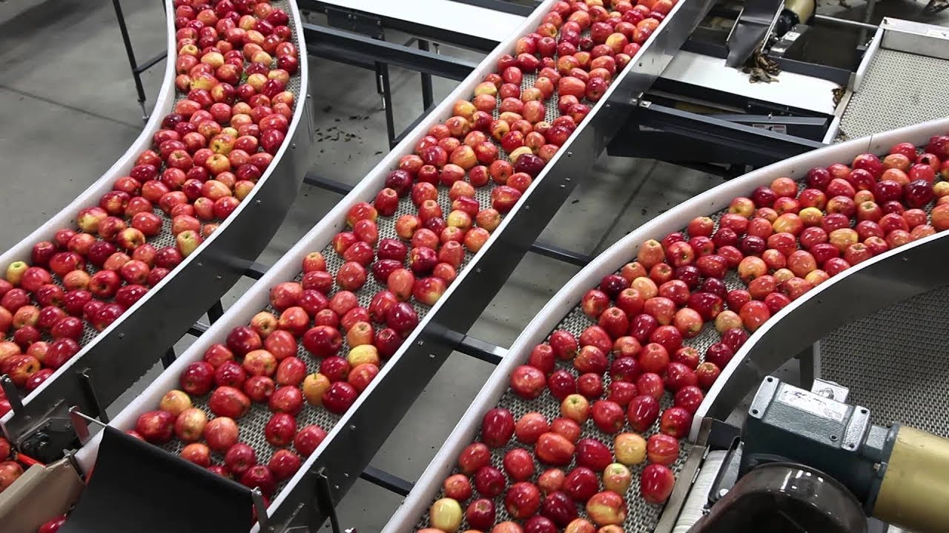
Products and processes

Slide 3
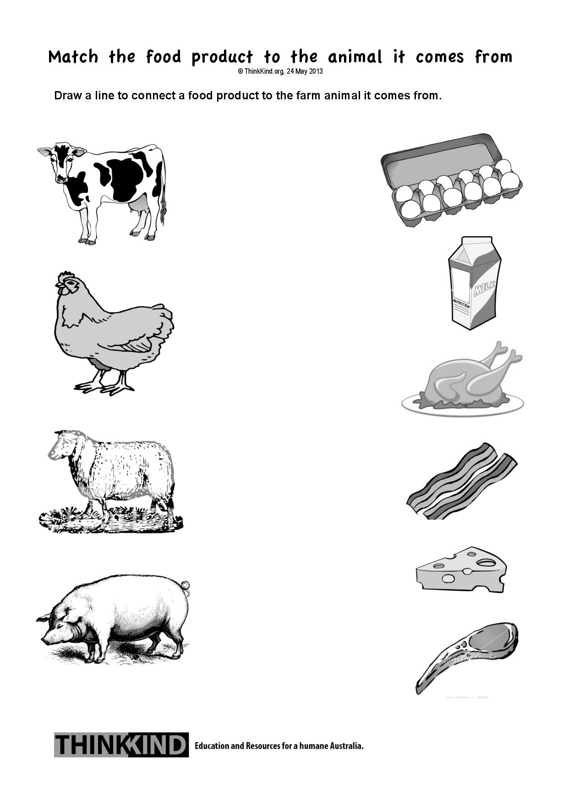
Products and processes group 1

Slide 4

Products and processes learners are required to colour the products in the worksheet accordingly

Slide 5
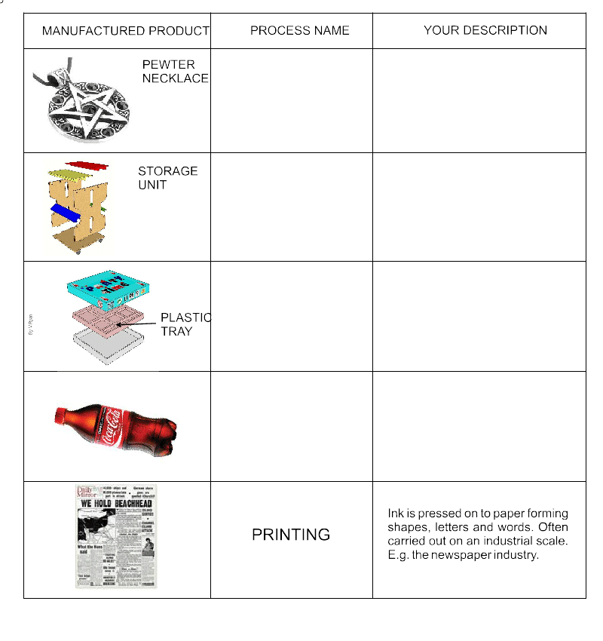
Product and processes group 2

Slide 6
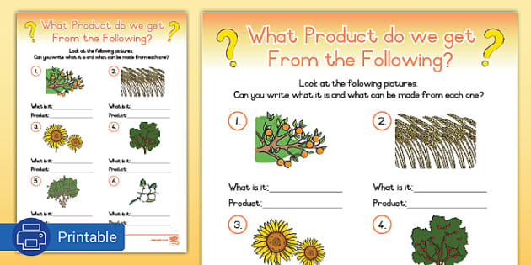
Products and processes
Group 3

Slide 7
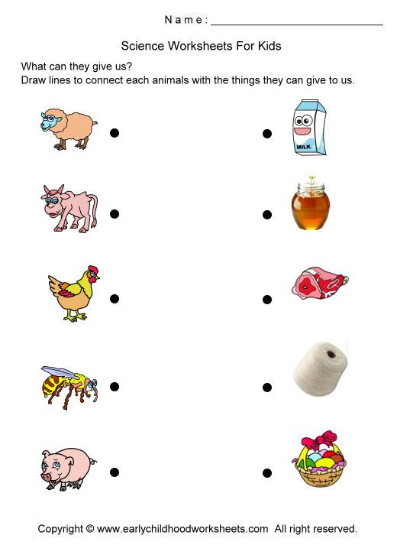
Animals that help us.
Group 1

Slide 8
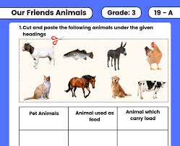
Animals that help us

Slide 9
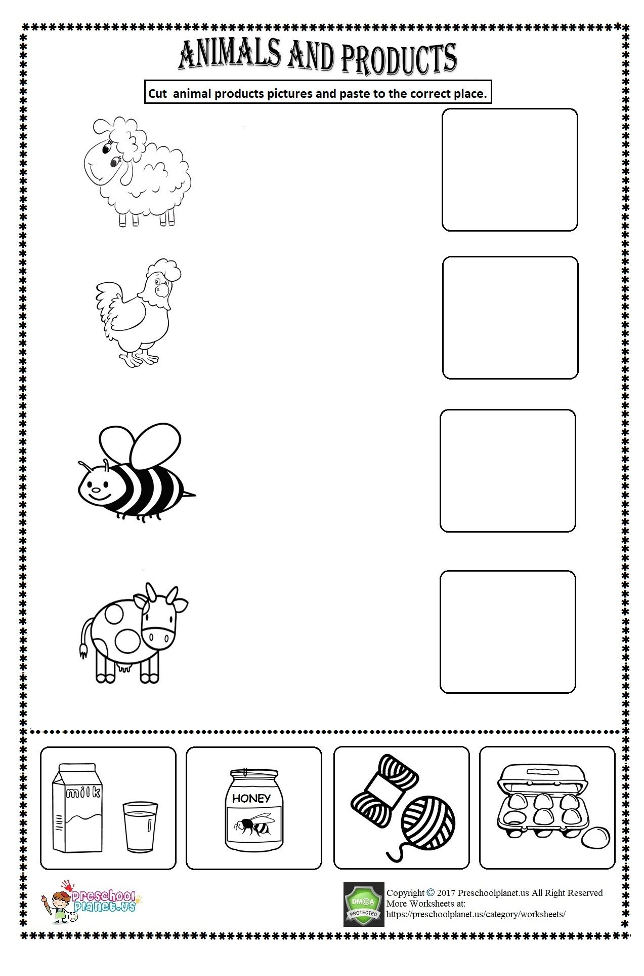
Animals that help us group 2

Slide 10
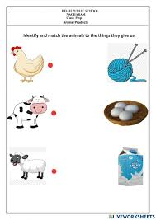
Animals that help us

Slide 11
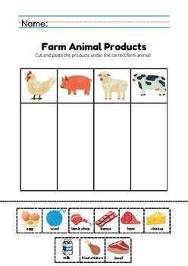
Animals that help us group 3

Slide 12
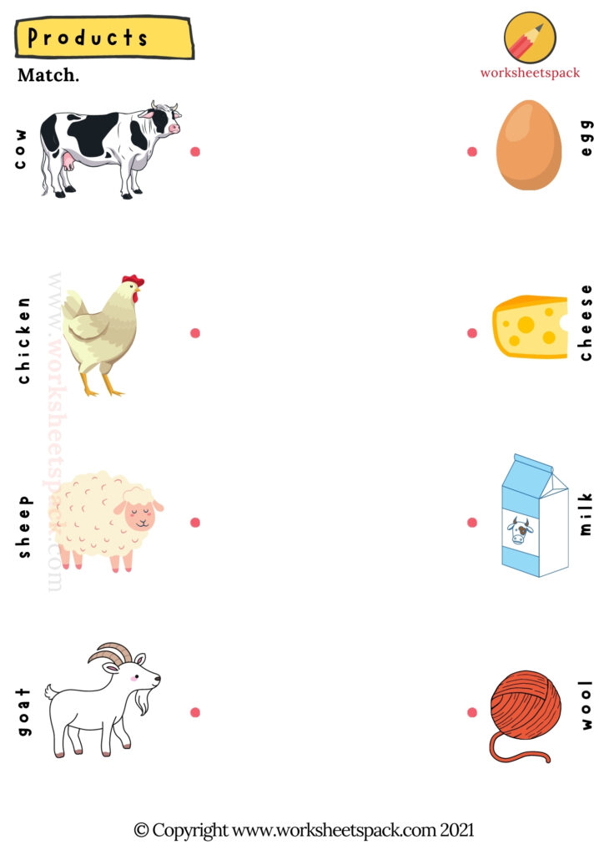
Animals that help us

Slide 13

World at work

Slide 14
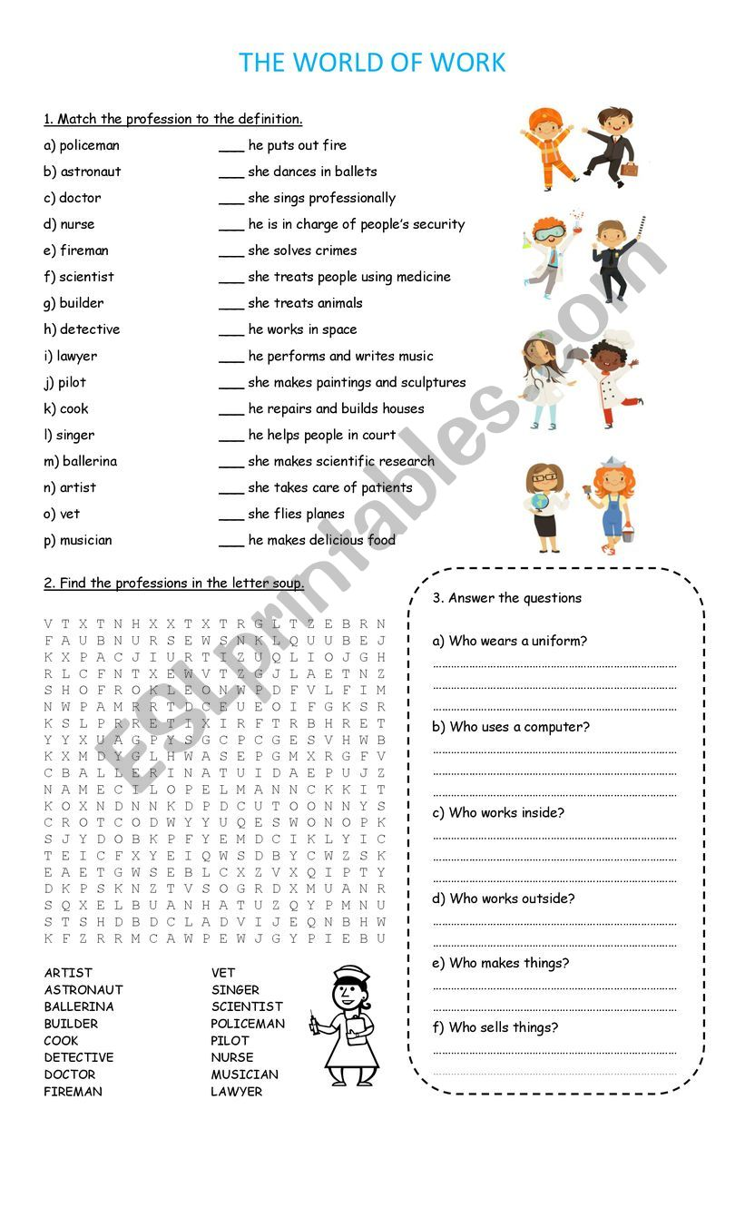
World at work group 1

Slide 15

World at work group 1

Slide 16

World at work group 2

Slide 17
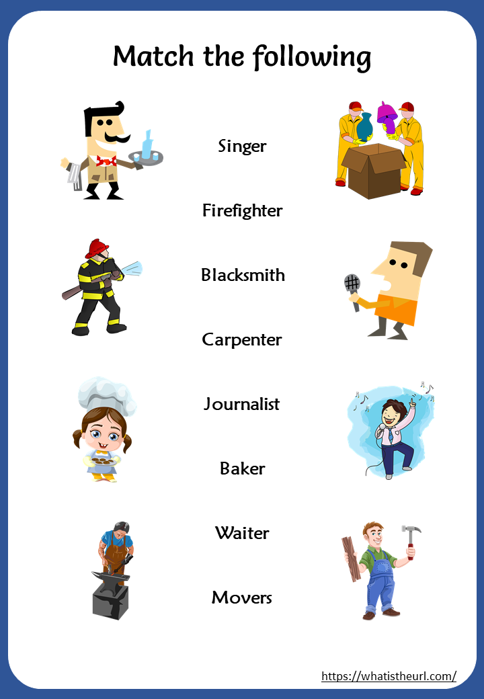
World aT work group 2

Slide 18

WORLD AT WORK
GROUP 3

Slide 19
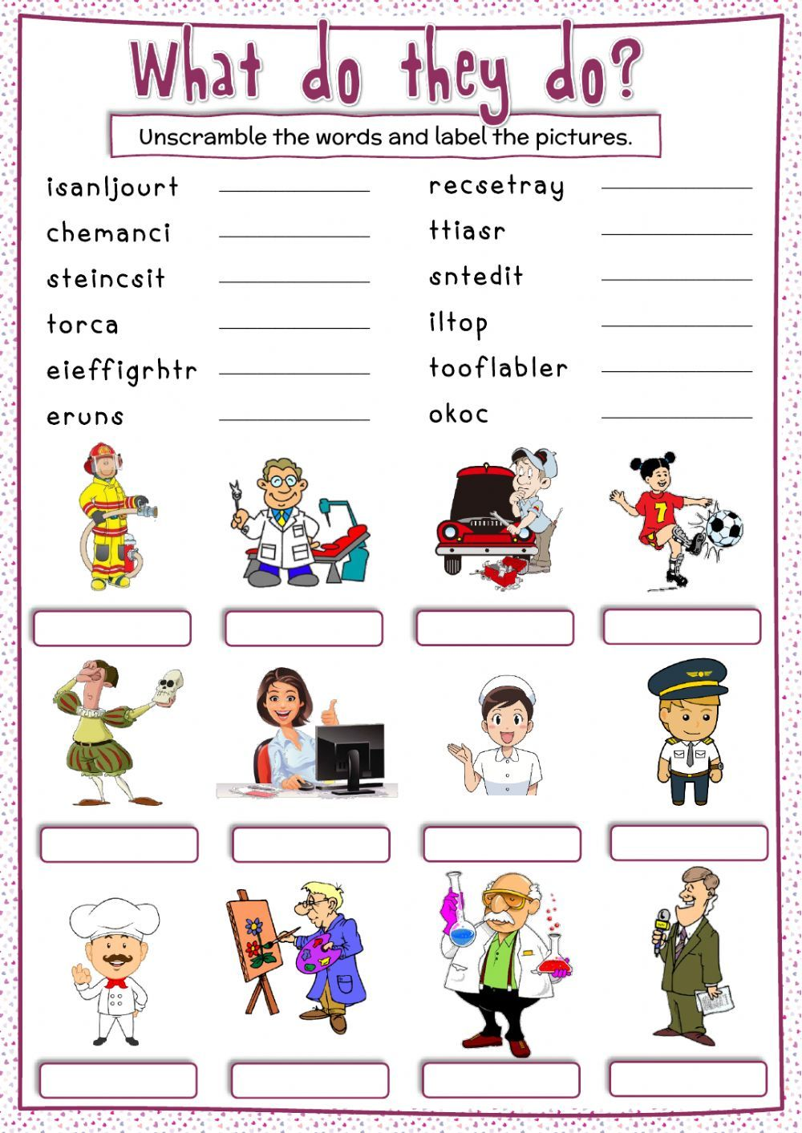
WORLD AT WORK
GROUP 3

Slide 20

I CAN BE AN ENTREPRENEUR

Slide 21

I CAN BE AN ENTREPENEUR
GROUP 1

Slide 22
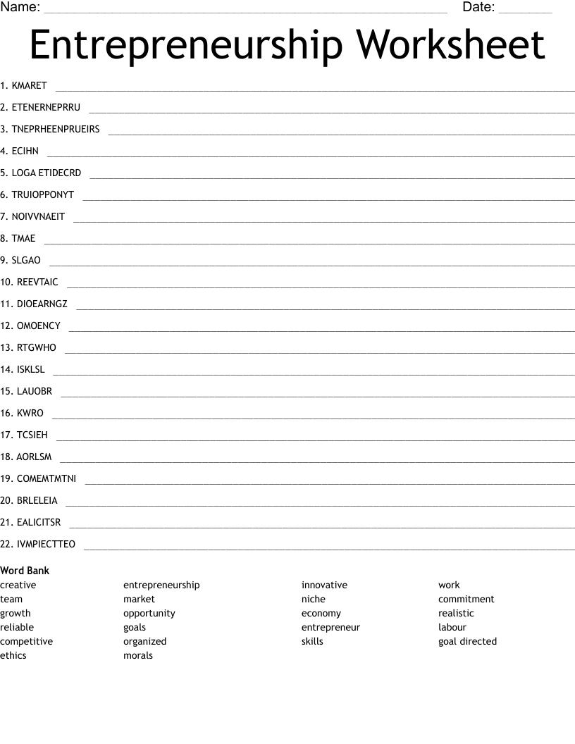
I CAN BE AN ENTREPRENEUR
GROUP 2

Slide 23
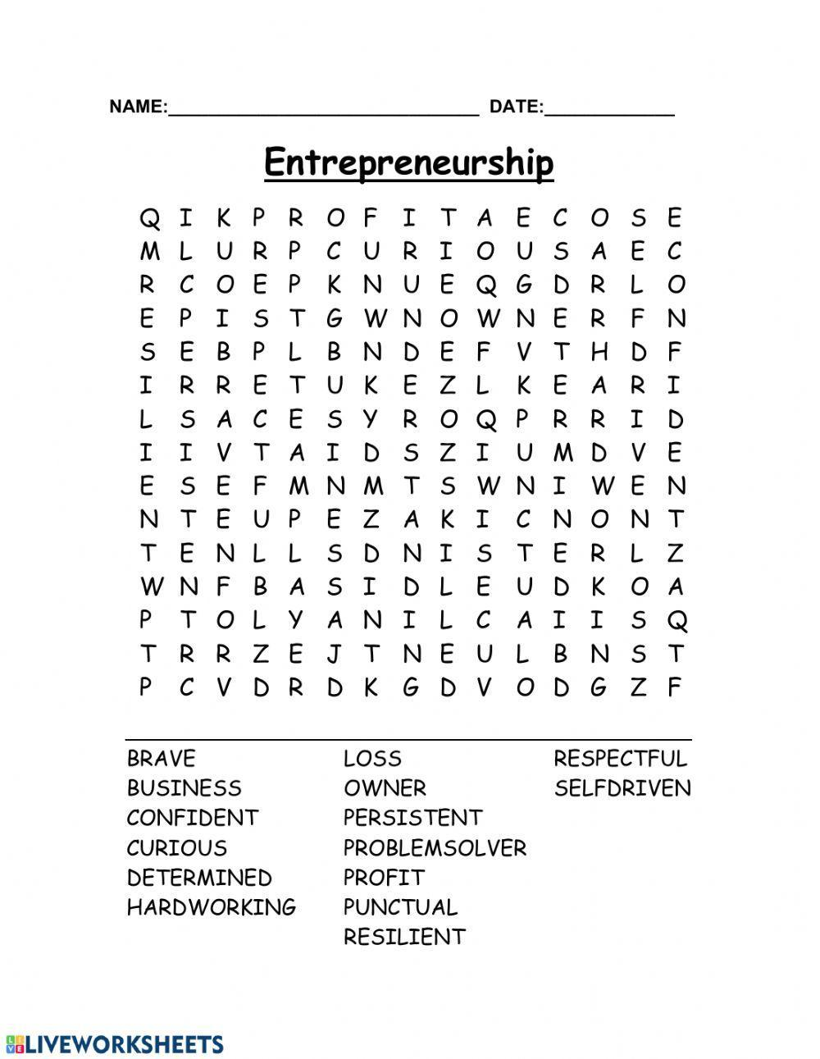
I CAN BE AN ENTREPENEUR
GROUP 2

Slide 24
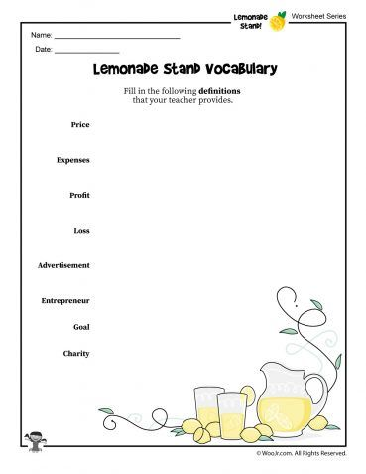
I CAN BE AN ENTREPRENEUR
GROUP 3
THE TEACHER WILL HAVE TO GIVE LEARNERS THE DEFINITION OF THE WORDS BELOW AND THE LEARNERS MUST WRITE THEM DOWN ON THE PROVIDED SPACE.

Slide 25
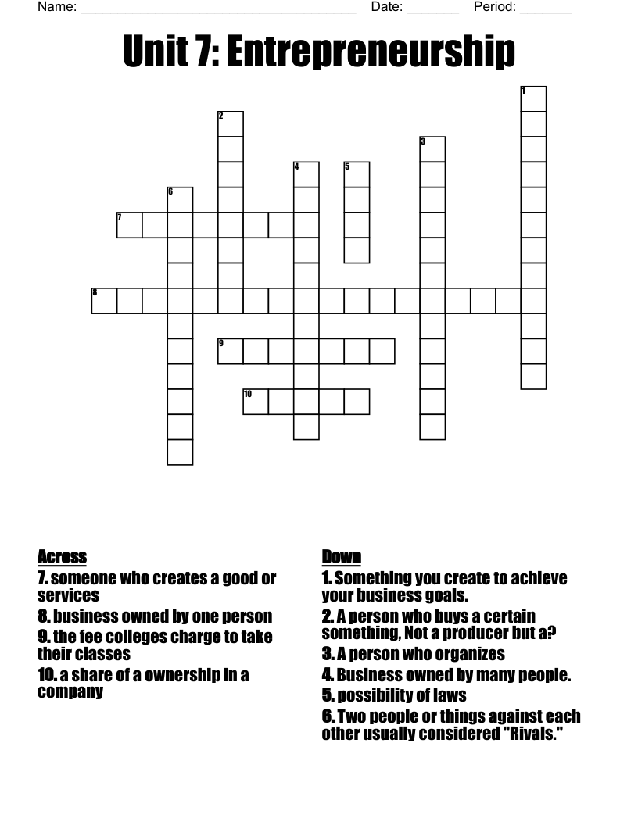
I CAN BE AN ENTREPRENEUR
GROUP 3

